Slide 1
Teacher ethics: the link between quality teaching and multi-ethnic and multiracial education
Helen J Boon
Brian E. Lewthwaite
James Cook University

Slide 2
The need for a multicultural approach in the classroom
Europe's population is fast changing as ethnic, racial, religious and economic diversity increases due to global economic forces and migration. In 2011, there were 33.3 million foreign citizens residing in the EU-27, representing 6.6% of the total population (eurostat, 2012). The latest OECD report (2015) indicates that on average across OECD countries in 2012, 11% of 15-year-old students had an immigrant background. Around 55% of these students were second-generation immigrants while 45% were first-generation immigrants;
First generation immigrant students’ academic outcomes are worse than those students without an immigrant background, and second generation immigrant students perform somewhere between the two.
Socioeconomic status conflates results BUT Belgium and Greece are the only OECD countries with immigrant student populations of over 10%, where the performance gap is large both before and after accounting for socio-economic status (40 and 30 score points, respectively).

Slide 3
Quality teaching
Teacher quality and teaching quality are characterised by pedagogy designed to maximise student learning by catering for individual’s needs. Teaching has been found to be most effective when the cultural heritages, prior experience, and performance styles of students are incorporated into the instructional process (Banks, 2010; Ladson-Billings, 2009). But these dimensions are often ignored in the instructional process (Gay, 2010) and teaching continues along Eurocentric agendas. On the other hand factors minority students’ discipline problems have been associated with cultural mismatch, implicit bias, and low expectations in classrooms and schools (Gregory et al., 2010; Gay 2010; Person & Hayward, 2015).
In order to modify their pedagogy to improve the learning of minority multiethnic students teachers must understand and value the diversity that these children bring with them into classrooms.
A multicultural approach to the teaching and learning process means the teacher is aware of the cultural, ethnic, and in the case of Australia, New Zealand, Canada and the United States, the Indigenous practices of students, and can use those practices to scaffold the learning of individual lessons as Vygotsky advocated decades ago (Vygotsky, 1978). Teachers must also have the dispositions and ethical orientations that place value on individuals of whatever colour or creed, demonstrated by a highly developed ethic of care (Snook, 2003).

Slide 4
Study Aims and methods
Interviews with 27 indigenous parents, 43 grade 9-12 students and also with indigenous teachers and a teacher administrator responsible for curriculum delivery and appropriate pedagogical practice for indigenous students and gathered information about the specific classroom behaviours that typified quality teaching for indigenous students.
These behaviours were endorsed as being culturally sensitive and responsive to indigenous students’ cultural identity and ways of learning. Emergence of 7 categories of behaviour that describe qualitatively the pedagogical characteristics identified as being important for Indigenous learners.
Educational psychology studies have found these qualities are also important for other minority student groups, whether that is due to ethnic minority status or sociodemographic minority status (Vygotsky, Maslow, Rogers etc).

Slide 5
Culturally responsive pedagogy (CRP) characteristics
Category | Description and examples
Ethic of care | An ethic of care is the foundation for all teaching practices. Teaching is characterised by respectful, positive and warm interactions with students.
Cultural value | Valuing students’ cultural identity, showing respect for students’ home language and having cultural knowledge which is used to scaffold children’s learning.
Literacy teaching | Literacy is explicitly taught from a foundation of spoken language. Code switching between Aboriginal English and Standard Australian English is explicitly taught. Reading strategies and writing are focused upon and repeatedly modelled in context.
Explicit teaching practices | Expectations of behaviour and achievement are clearly and repeatedly communicated to students. The knowledge and skills needed by students are explained and modelled in a variety of ways; feedback is regularly offered.
Pedagogical expertise | The teacher behaves as a learning facilitator; students are given choices, open ended, experiential, group and outside activities from which to learn. Visual imagery is used to prompt engagement and support learning. Information and skills are chunked and scaffolded, and connected to prior knowledge.
Behaviour support; Support for self-regulation | Students contribute to the setting of classroom expectations, which are clearly and consistently communicated to students. Use of cooperative learning behaviours, engaging and accessible tasks and established routine decrease the need to manage student behaviours.

Slide 6
Pearson’s correlations between subscales of CRP (N=138)
 | 1 | 2 | 3 | 4 | 5 | 6 | 7
ethic of care | 1 | .656** | .514** | .673** | .554** | .583** | .567**
2. pedagogical expertise | .656** | 1 | .676** | .683** | .694** | .665** | .682**
3. literacy teaching | .514** | .676** | 1 | .542** | .573** | .469** | .694**
4. behaviour support | .673** | .683** | .542** | 1 | .586** | .579** | .484**
5. explicitness | .554** | .694** | .573** | .586** | 1 | .577** | .477**
6. self-regulation support | .583** | .665** | .469** | .579** | .577** | 1 | .443**
7. Indigenous cultural value | .567** | .682** | .694** | .484** | .477** | .443** | 1
**. Correlation is significant at the 0.01 level (2-tailed).

Slide 7
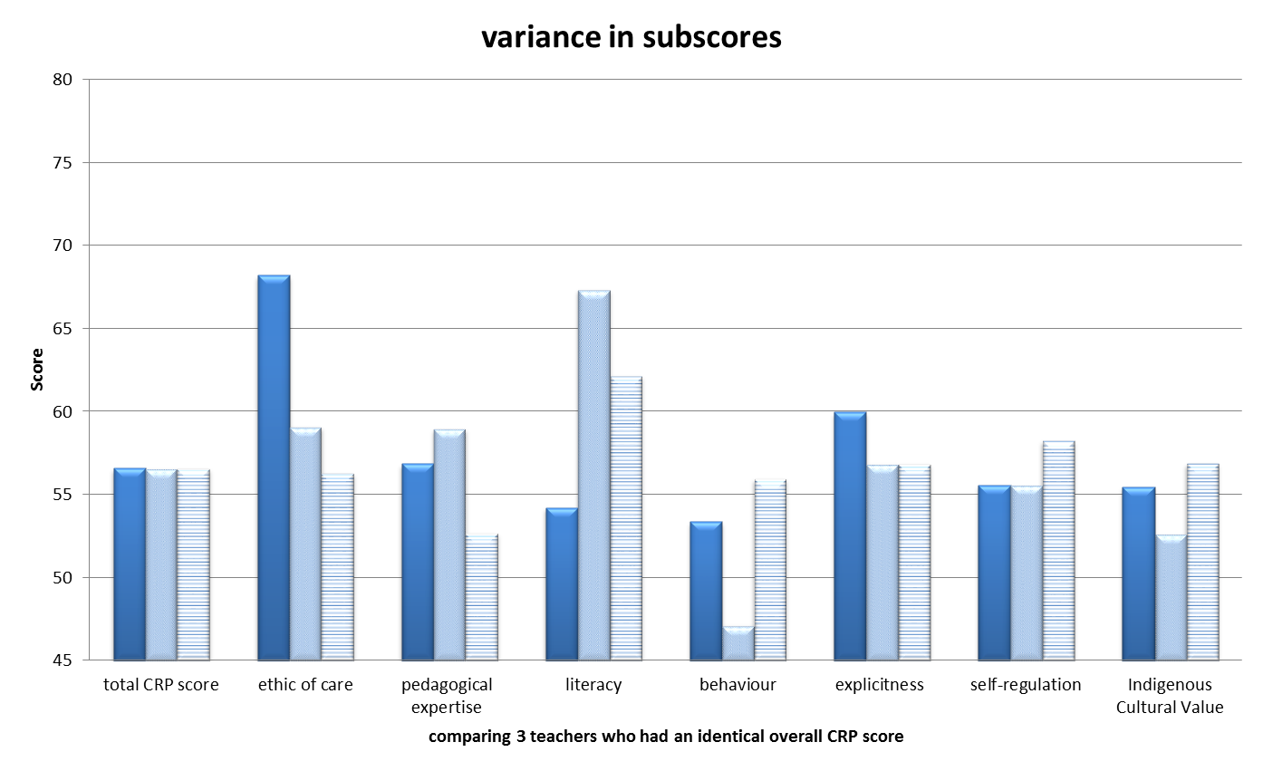
Comparing 3 teachers with identical overall score on CRP

Slide 8
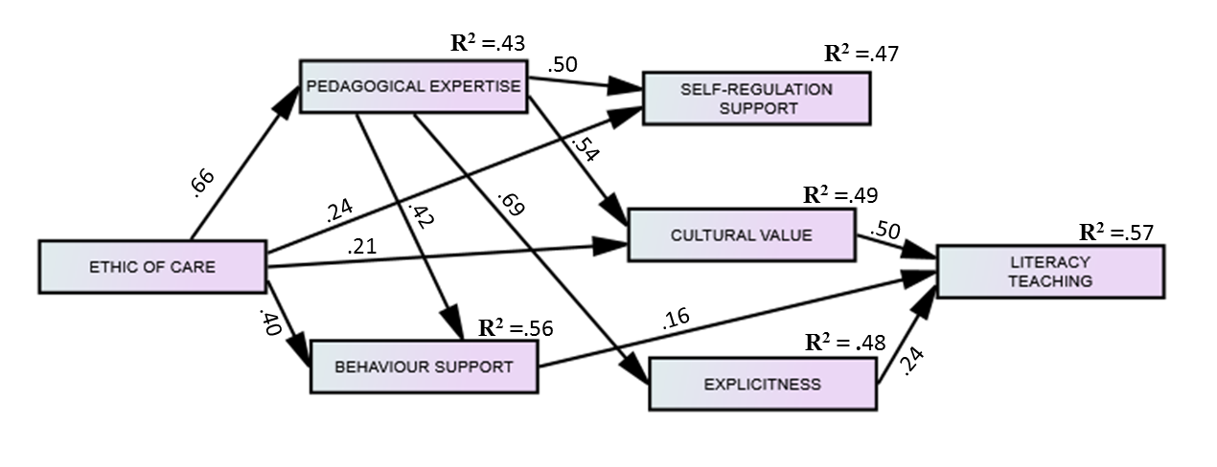
Structural Equation Modelling of the factors of the CRP (N=138)

Slide 9
DISCUSSION
The findings reported here constitute one of a very few studies that have empirically investigated culturally responsive pedagogy. Moreover, CRP as described can define quality teaching for multiethnic and multiracial students who like Australian Indigenous students might have unique ways of learning but underachieve due to language barriers and a range of factors linked to socioeconomic disadvantage.
Quality teaching was empirically found to be based on factors that include explicit instruction, literacy teaching, which enhances language development, high teacher expectations communicated via pedagogical expertise and cultural value, and behavior support which helps to minimize disciplinary action based on cultural misunderstandings and low teacher expectations giving rise to self-fulfilling prophecy developments (Perso & Hayward 2015). With minimal rewording the items pertaining to the factor Indigenous cultural value could be adapted to fit with any number of multiethnic groups found in a classroom.

Slide 10
Conclusion
Quality teaching stems from viewing teaching as a vocation not merely an occupation, and as Caena (2011) found there is an empirically identifiable link which distinguishes good teaching from quality teaching; quality teaching is characterized by being ethically defensible, and is distinct from good teaching, which merely shows that learning took place.
Finally it is worth recalling that economic development is integrating businesses, families, intellects, and organisations into global affiliation. These changes bring different cultures together at virtually every level of society, in almost every country of the world. There are therefore immense benefits for all students in bringing into the classroom an understanding and value for diverse cultures.

