Slide 1
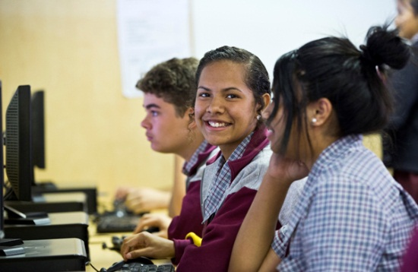
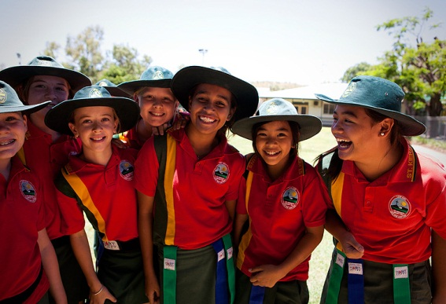
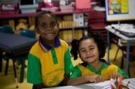


Seeking a Pedagogy of Difference
“Responding to Indigenous Students and their Community’s Voiced Experiences Regarding Effective Teaching Practices”
7th Queensland Aboriginal & Torres Strait Islander Conference
Rockhampton
Tammi Webber, Gail Laffin,
Brian Lewthwaite, Helen Boon
pedagogyofdifference.com
http://edwardsdean.net/jcu/project_management/index.php

Slide 2

acknowledgement of country
ACKNOWLEDGEMENT OF COUNTRY
& of Indigenous people present
Notes:
Gail: Acknowledge the land on which we gather on today was, is, and always will be traditional Indigenous peoples land. Furthermore we acknowledge any Indigenous Elders both past, present, and future as they hold the knowledge, the memories, and the wisdom of our peoples across the globe. Intro Tammi & Gail.

Slide 3
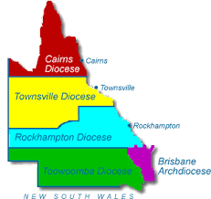



What is the focus of the Project?
Mandate for Catholic Education:
to improve equitable outcomes for its Indigenous students
Catholic Education recognises that engaging teachers in inclusive curriculum practices is a central focus in its commitment to provide equitable learning outcomes
To find out the teaching practices that best support Aboriginal and Torres Strait Islander students in their learning
Notes:
Tammi: Acknowledge the Catholic Church’s role in the colonization of Indigenous peoples around the world, & the impact and legacies that continue as part of European assimiliation. Great commitment to Indigenous students. Largest ratio per head for Indigenous students across Australia.

Slide 4
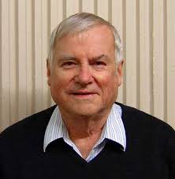
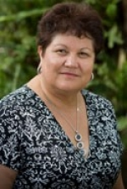
Concerns Across the Tasman
Concern that Hattie’s work is now generalised across all contexts & does not address cultural or social perspectives (decontextualised ‘invisible’) (Snook et al, 2013).
Nationalistic agendas override Indigenous peoples aspirations for education, especially in the important space of teacher-student interaction (McKinley, 2010). The “Closing of the Gap” objectives (2009); New National curriculum with Embedding Indigenous Perspectives as a cross curriculum priority in every subject area; Personalised Learning Plans for ALL Indigenous students.
“There is astoundingly little known about what Aboriginal students see as the qualities of effective teachers and the impact this has on educational outcomes.” (Craven, 2011).
Notes:
Tammi: Lots of qualitative data, no quantitative research. Lots of information from black academics, & from programs the have had great success within Indigenous contexts. However, no one in Australia has ever asked in this context, Indigenous parents & students what we see as makes a good teacher. Providing a ‘voice’ to our mob

Slide 5
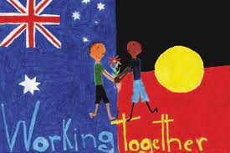
Our Research &
Development Work
Phase One (2014): Conversations with students (26), parents (26) and teachers (26) to identify the teacher actions that influence student engagement & learning
Phase Two (2015): Develop Effective Teaching Profiles used to inform changes in practices – professional learning handbook and web-based evaluation tool for self-profiling
Phase Three (2015-16): Work with teachers of Grade 4, 5 & 6 over the next three years (2015-2017)
Phase Four (2015-2017): Determine influence of these practices on student engagement and learning –
We want to find out what teacher behaviours as voiced by Aboriginal and Torres Strait Islander students and their communities have the most effect on learning
Notes:
Tammi: We are currently between phase 3 & 4

Slide 6
Phase One Responses
Parents, Students & Teachers
In groups, read:
  Parents comments
  Student comments
  Teacher comments
  Note how they are similar, how they are different
  What do parents want teachers to know?
  What do students want teachers to know?
  What do teachers know and not know?

Slide 7
Conversations With Parents
28 parents across 4 schools (Townsville and Mount Isa)
Open-ended conversations
On average, 45 minutes long, and often with an Indigenous teacher or education worker
What are some things that you would like your child’s teachers to know that would help them in their learning?
What can teachers do to help your child or children in their learning?
Notes:
Tammi

Slide 8
General themes
From Parents:
Understanding Our History with education
Understanding the “Code-switching” required of our children
Understanding our perceived Inability to Change Schooling as it exists today
Wanting teachers and schools to hold an Alternative Point of View of Indigenous students and the communities they represent
Wanting schooling and teaching to affirm Cultural Identity
Ensure Learning Priorities are broader than achievement
FOCUSSED MAINLY ON SYSTEMIC ISSUES IN EDUCATION

Slide 9
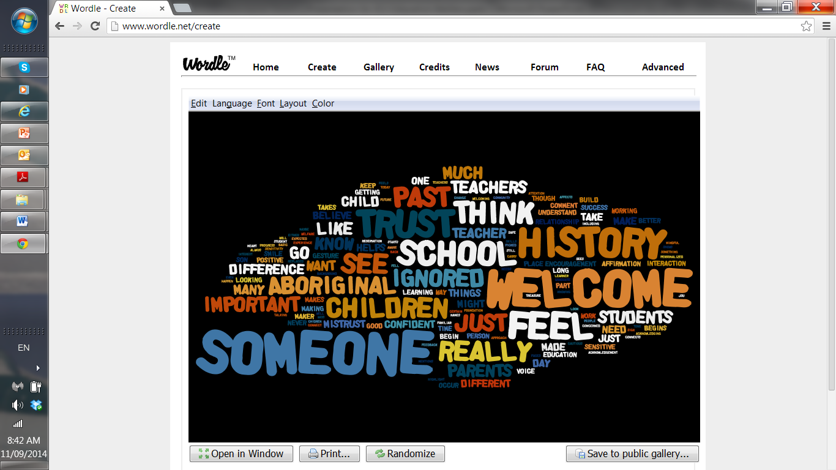
Notes:
Tammi

Slide 10
Conversations with Students
Questions asked:
Next year, you will get a new teacher [for a subject]. What do you want that teacher and classroom to do to help you to learn?
Tell me about classrooms and teachers where you feel good about yourself and learning
Notes:
Gail

Slide 11
General themes from Students:
A classroom climate of ‘warm expectations’
Building cultural bridges as a foundation for respect and learning
Making provision for development of literacy (and numeracy) fluency
There is a tendency towards explicit instruction, emphasising a gradual release of responsibility
Student diversity is accommodated to promote individual engagement and success
A variety of practices support student learning
Being attentive to student health and well being
Developing a classroom environment that supports learning through mainly proactive measures, especially relational
A classroom environment that affirms and welcomes and includes community resources, both physical and human
STUDENTS RESPONSES WERE FOCUSSED ON CLASSROOM PEDAGOGY
Notes:
Gail: best practice worldwide: relationships, understanding the learner, scaffolding, modification & differentiation, creative & resourceful.

Slide 12
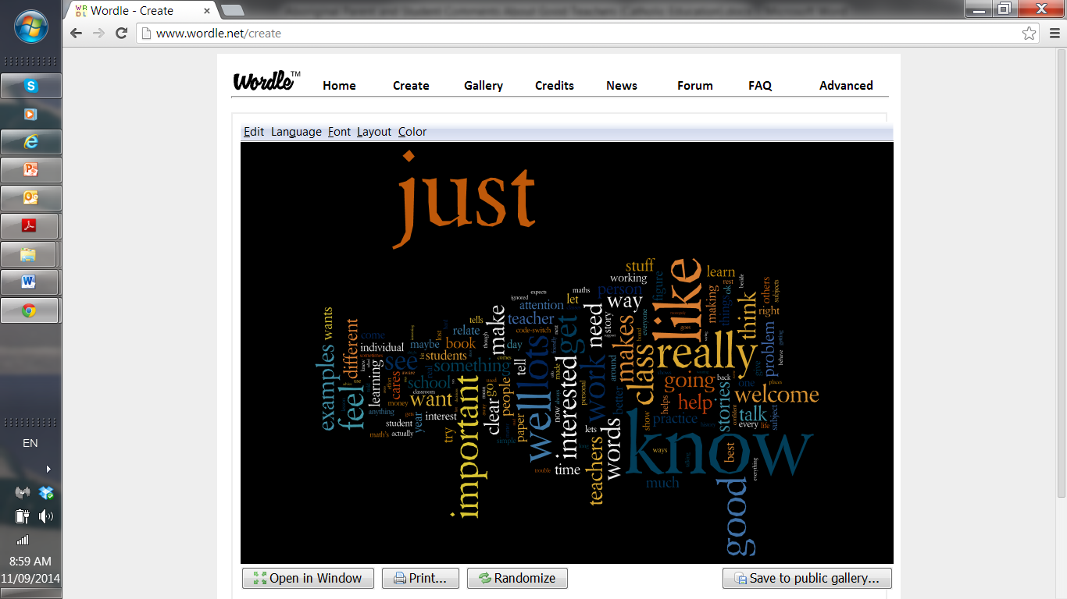
Notes:
Gail

Slide 13
General themes from Teachers:
Essential classroom skills as being ‘well developed & diverse teaching skills.’
Individual accommodation: differentiate instruction to address variability in student capabilities.
Developing students’ holistic needs not just academically but socially, spiritually, and occasionally culturally.
Identified affective relationships, are a critical component to building positive relationships and affirming students in their learning.
Students adjustments and code switching in negotiating the demands of schools, particularly in reference to English language.
Emphasis on explicit teaching with learning goals, demonstrations, focus on learning processes, gradual release of responsibility, and scaffolded inquiry.
Importance of creating a supportive environment.
Importance of relevant learning, not abstract concepts.
Teachers verbalized an ethic of care, but not an ethic of practice.
Notes:
Gail: 60 teachers across the 4 schools completed the CRP on-line questionnaire (60 items)

Slide 14
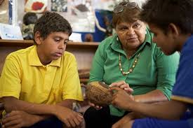

Parents
Teachers
Affective Relationships
Code switching
Students
Notes:
Tammi

Slide 15
Phase Two Instrument:
An instrument – 64 questions - that profiles teachers according to the attributes of effective teachers identified by parents, students and teachers
Factors include attention to:
  Ethic of care – attention to the individual – verbal and non-verbal
  Pedagogical expertise – diverse practices
  Literacy – attention to literacy demands
  Behaviour support practices –proactive relational
  Explicitness – communication patterns
  Self-regulation – working to mastery and independence
  Indigenous Cultural Value – affirmation of being culturally located

Slide 16
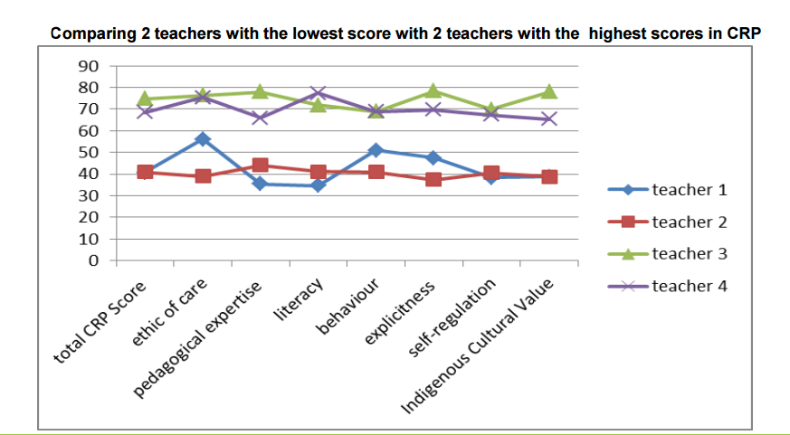
Comparing 3 teachers with identical overall score on CRP
2 highest & lowest teacher results, identified change in secondary
Notes:
Tammi

Slide 17
Phase Three
Significant influential items (qualitative):
  Individual attention to learning needs – one-on-one interactions
  Explicitness of instruction
  Undertalking
  Attention to literacy demands – words added to what is visual
  Time for mastery
  Relevance – engagement around narrative

Slide 18
Phase Four
Professional Learning
1.4: Design and implement effective teaching strategies that are responsive to the local community and cultural setting, linguistic background and histories of Aboriginal and Torres Strait Islander students.
6.2: Participate in learning to update knowledge and practice, targeted to professional needs and school and/or system priorities.
6.3: Contribute to collegial discussions and apply constructive feedback from colleagues to improve professional knowledge and practice.

Slide 19
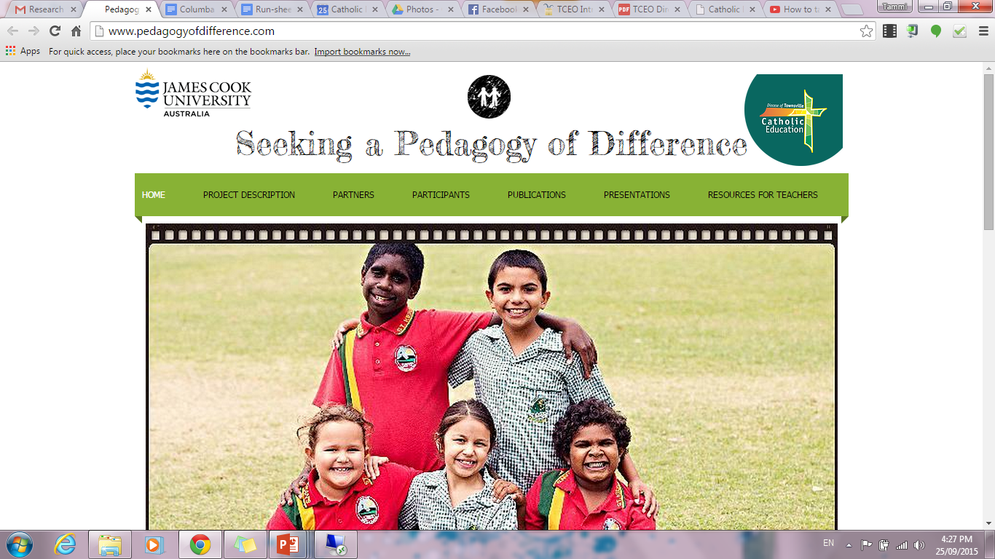
Further Information available on website:
www.pedagogyofchange.com
Notes:
Tammi: website for further information, findings, & journals. In the next month an online assessment tool as a survey for teachers to measure their CRP. Future proposals: Secondary research, & support tools/resources for teachers.

Slide 22
Pedagogy of Difference
Web-based Teacher self-assessment tool – to be completed after the initial consideration around the eight categories
15 minutes to complete
Teachers must do it reflectively with attention to all students, especially their Aboriginal and Torres Strait Islander students and parents
When complete, they can print their profile
Then discussion around areas of strength and weakness
Use the handbook to inform discussion and identify practices to change
Teachers identify areas for improvement and feedback
Current link:
http://edwardsdean.net/jcu/project_management/index.php

Slide 23
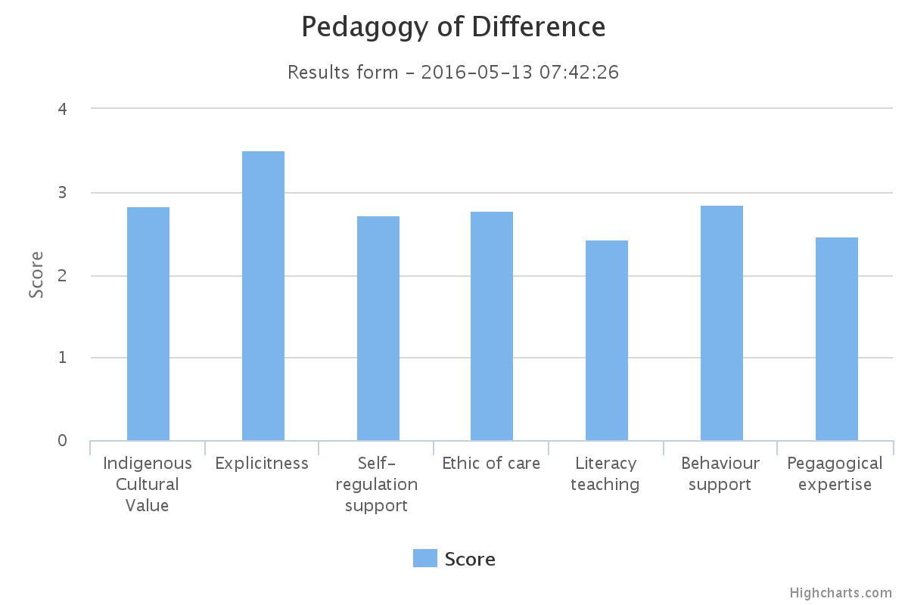

Slide 26
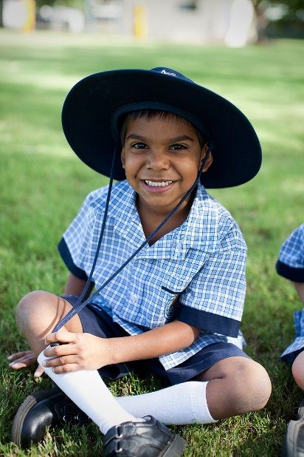

The future of our nation rests on the quality of our teachers, and their willingness and ability to make a real difference.
Craven, R. (2011:21)
Thank you for listening
Notes:
Tammi.

